Slide 1
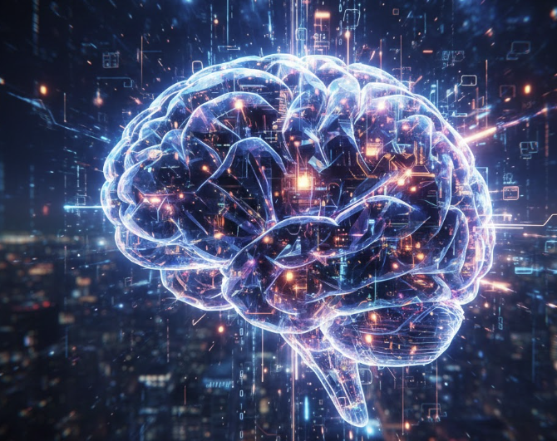
AI Life Cycle & Evolution from ML → DL → GenAI
Harsh Dalal

Slide 2
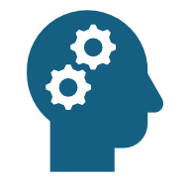
Agenda
Introduction to AI & AI Life Cycle
What is Machine Learning?
Supervised vs Unsupervised Learning
Deep Learning & Why It Became Dominant
Why GenAI & LLMs Lead Today’s AI Revolution
Evolution: ML → DL → LLMs → GenAI
Real-World Transition Across Industries
Summary & Q&A

Slide 3
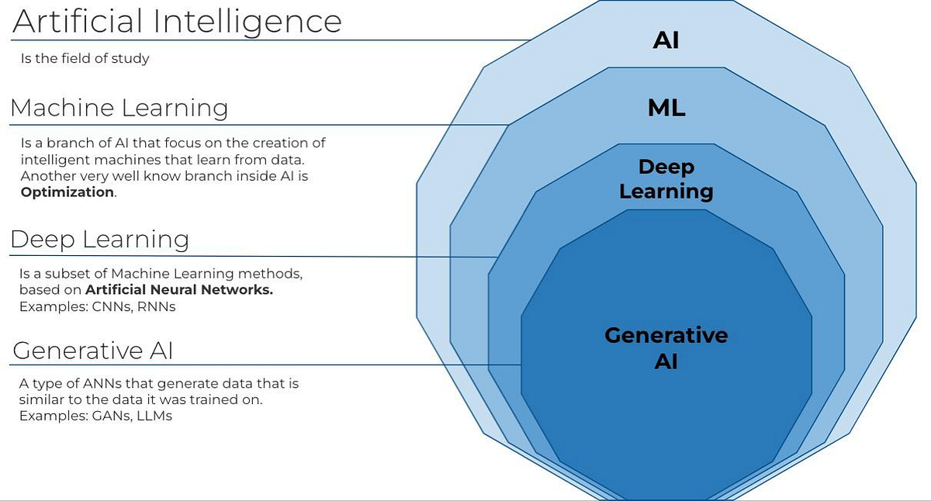
AI Evolution

Slide 4
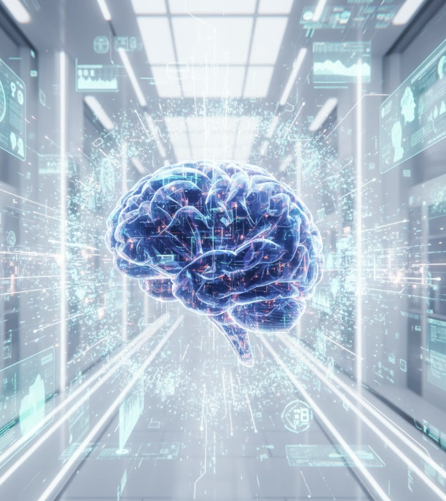
AI Life Cycle
Problem Definition
Data Collection
Data Cleaning & Preprocessing
Feature Engineering
Model Selection (ML/DL)
Training & Validation
Evaluation & Metrics
Deployment (API / App / Cloud)
Monitoring & Improvement

Slide 5
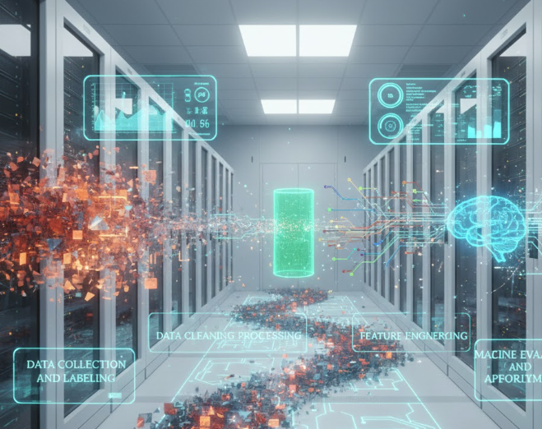
What is Machine Learning
ML enables systems to learn from data without explicit programming.
Uses algorithms to find patterns → make predictions.
Used for classification, regression, clustering, recommendation, forecasting.

Slide 6
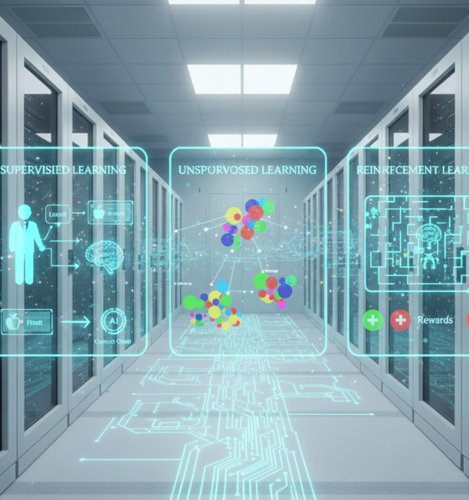

Types of Machine Learning
Supervised Learning – Labeled data → Predict target.
Unsupervised Learning – No labels → Discover structure.
Reinforcement Learning – Agent learns via rewards.

Slide 7
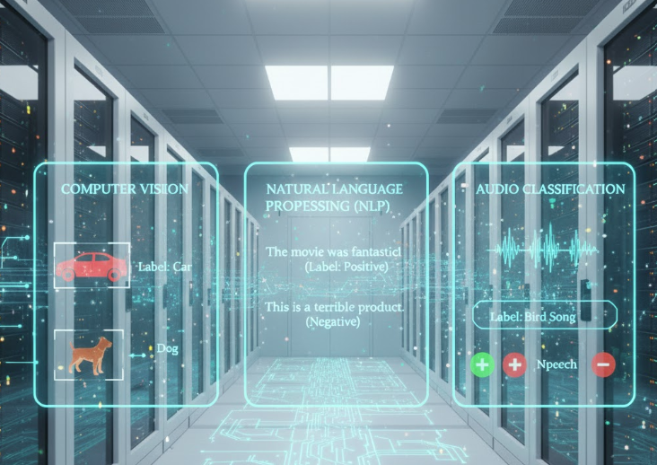
Supervised Learning
Trained on input + correct output (labels).
Algorithm learns mapping between X → Y.
Examples:
Email spam classification
Credit risk prediction
Fraud detection

Slide 8
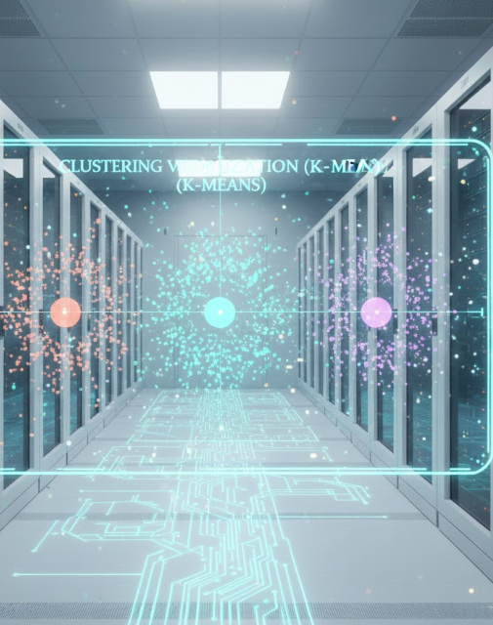
Unsupervised Learning
Trained on unlabeled data.
Finds clusters, patterns, associations.
Examples:
Customer segmentation
Market basket analysis
Anomaly detection

Slide 9

Why Deep Learning Became Dominant
Handles huge data + complex patterns automatically.
No heavy manual feature engineering.
Uses multi-layer neural networks for high accuracy.
Enabled by GPUs, TPUs, large datasets.
Excels in vision, speech, NLP.

Slide 10
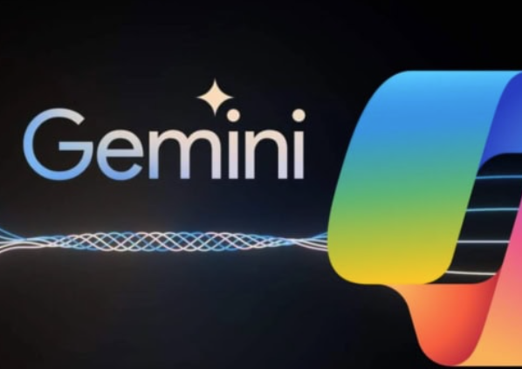
Why GenAI & LLMs Dominate Today
LLMs (e.g., GPT, Gemini, Llama) trained on trillions of tokens.
Understand context, reasoning, coding, content creation.
Replace traditional models with multi-task capability.
Zero-shot and few-shot learning eliminate need for labeled datasets.
Foundation models → reusable across domains.

Slide 11
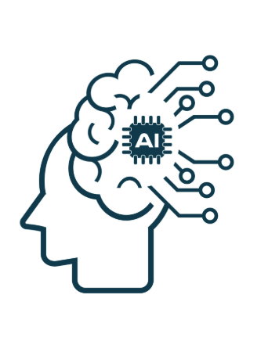
Summary
AI lifecycle defines complete process from idea → deployment.
ML = pattern learning; DL = large neural networks; GenAI = foundational models.
Deep learning & GenAI dominate due to scale, accuracy, automation, and reasoning ability.
Industries are shifting rapidly from ML → DL → LLMs for productivity and automation.

Slide 12
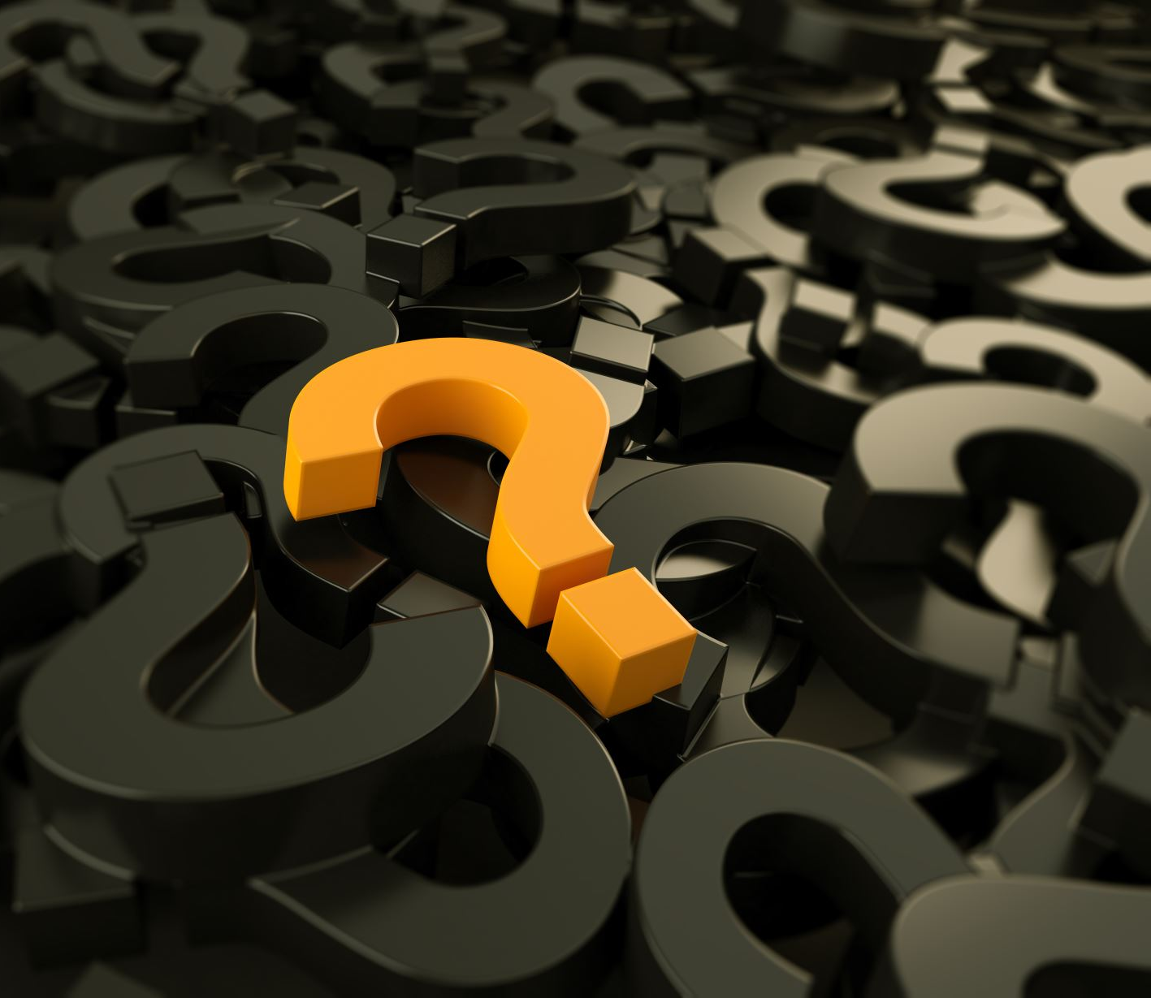
Any question?

Slide 13

Thank you

